Slide 1



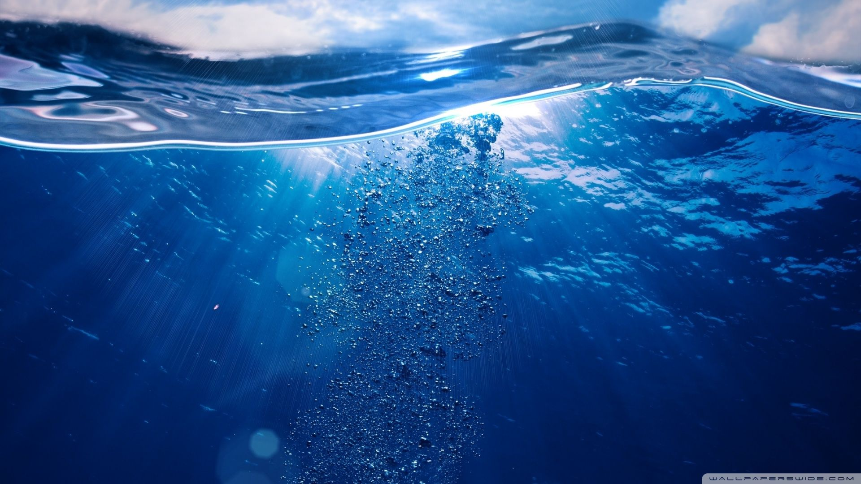
Development of innovative anodes for energy-efficient electro-oxidation of contaminants in wastewater
Speaker: Keyvan Mirehbar

Slide 2
Background
Bachelor’ Degree
Master’s Degree
Research Experience
Chemical Engineering at Science & Research University in Tehran-Iran
Water Treatment by Electrolysis Method
Environmental Engineering at Warsaw University of Technology
Internal Microelectrolysis in Combination with Advanced oxidation Processes for Landfill leachate treatment
Universidad Autonoma de Madrid
Synthesis and electrochemical characterization of new iron-based nanoparticles as heterogeneous catalysts to be used in hydroxyl and sulfate radical-based water treatments

Slide 3

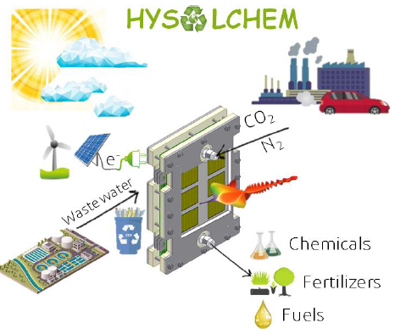
HySolChem is developing an innovative, low-cost reactor for capturing greenhouse gases and producing high-value fuels and chemicals, while contextually removing harmful pollutants from wastewater with photosynthesis.
Photoelectrochemical CO2/N2 reduction
Electrochemical oxidation of microplastics/organic pollutants
from wastewater
Ion-exchange membranes

Slide 4

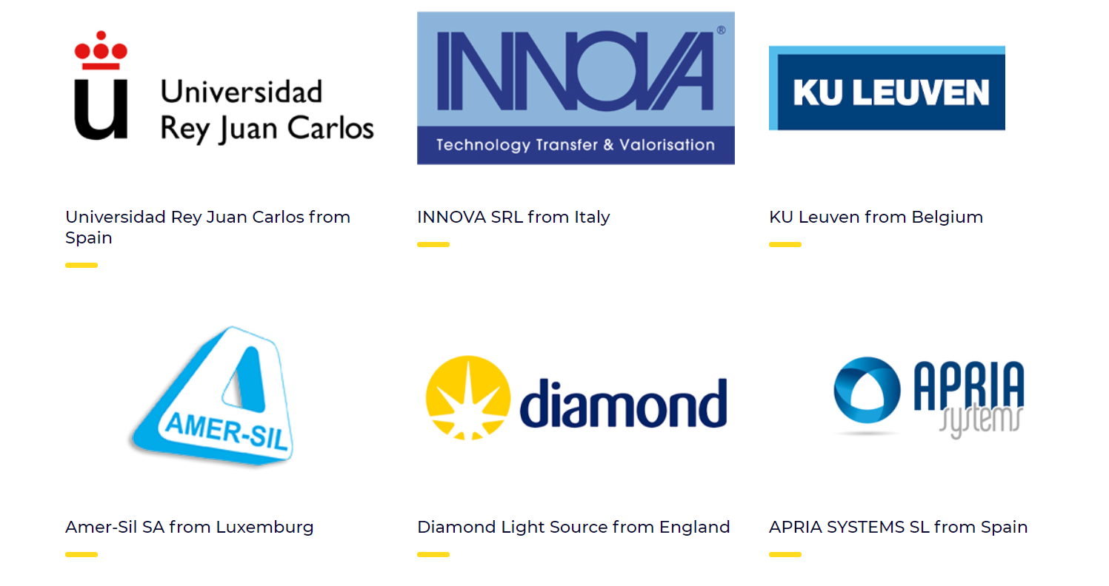

Slide 5
HYSOLCHEM Main Objectives
1
To integrate ‘design-synthesis’ efforts towards the design of innovative photocathodes based on inorganic oxide semiconductors (IOS)
2
To develop efficient, low-cost and long-duration anodes for the electro-oxidation of microplastics and other organic pollutants in wastewater
3
To design and fabricate ion-exchange membranes
4
To determine the reaction mechanisms
5
To integrate in a solar-powered flow reactor
6
To validate the prototype in a wastewater treatment plant
7
To study the performance of the developed materials and devices

Slide 6
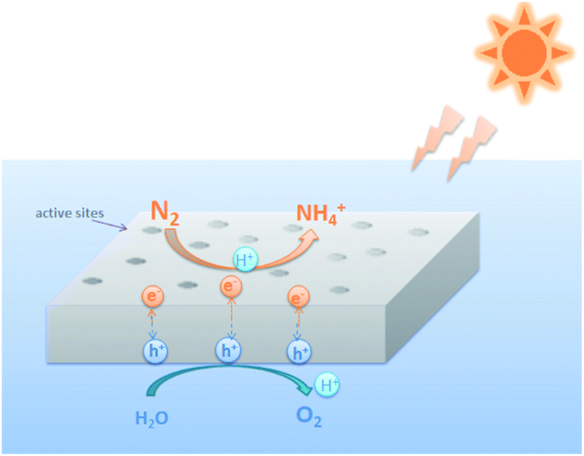
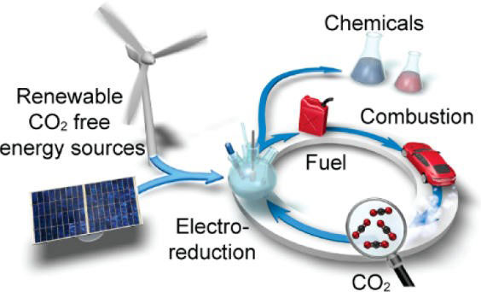
A bit More Detailed…

Slide 7
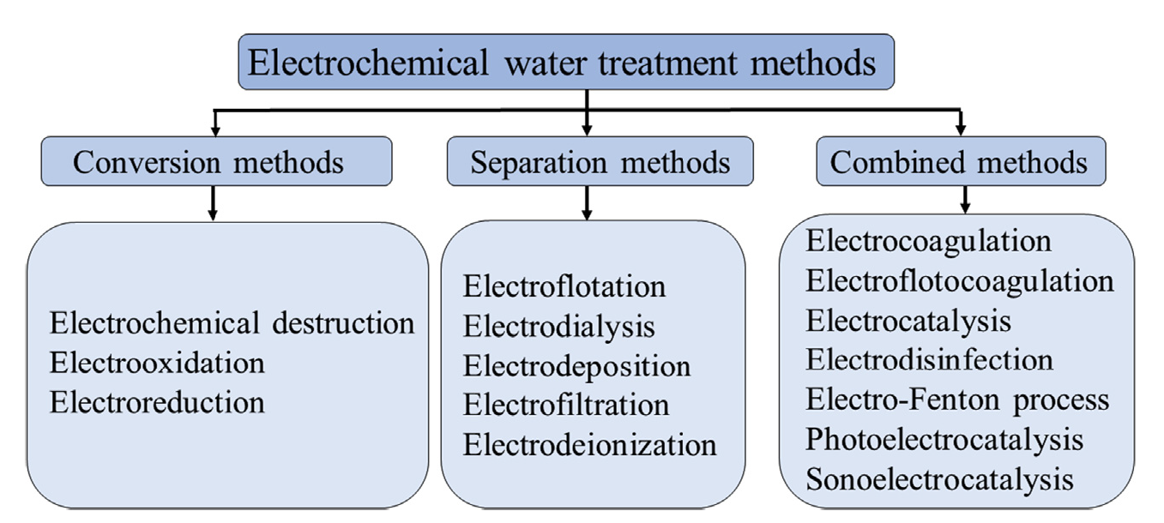
Electrochemical Water Treatment methods

Slide 8
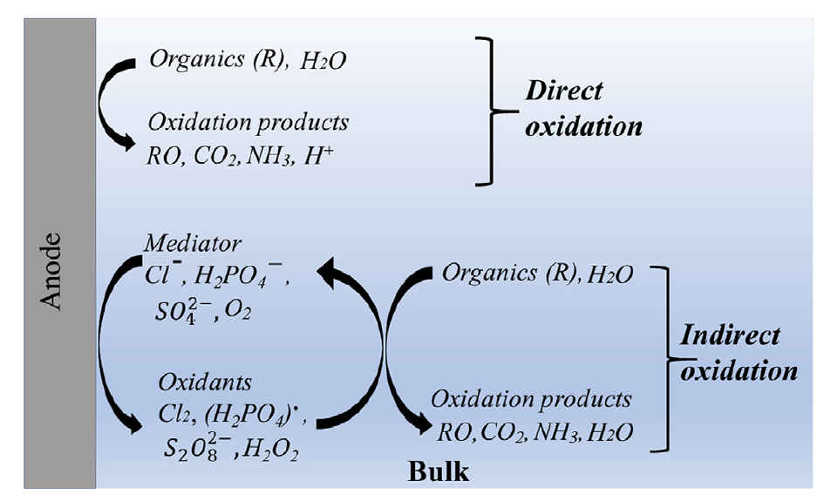
Electrochemical Oxidation
Also called:
Anodic oxidation
Cold combustion
Electrochemical incineration
Direct Mechanism
Indirect Mechanism

Slide 9
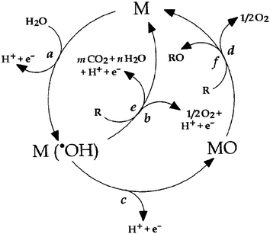
Direct Oxidation
Direct EO of organic pollutants involves direct active oxygen interaction with organic pollutants with their further oxidation.
Dissociative adsorption of water
H2O + M → M-OH + M-H
M-H → M + H + e
H2O + M → M-OH + H + e
Electrolytic discharge of water
H2O + M → M(OH) + H + e
+ -
+ -
When bond energy of M-OH and
M-H is higher than dissociative energy
of water to H and HO radicals
.
+ -
when the bond energy of M-OH and M-H is lower than
dissociative energy of water to H and HO

Slide 10
Direct Oxidation
In case of presence of organic pollutants depend on the type of the anode two different mechanisms can happen:
Active anode (strong adsorption of OH.)
M(OH) → MO + H + e
MO → M + 1/2O2
MO + R → M + RO
Non-active anode (weak adsorption of OH.)
M(OH) + R → M + mCO2 + nH2O + H + e
.
+ -
.
+ -

Slide 11
Type of electrode | Advantage | Disadvantage
Noble metal electrodes | Stable in a wide range or potentials and pH Excellent repeatability properties Intensive use in laboratory scale for new process investigations | Expensive Low mineralization efficiency Low overpotential toward OER Poor use in industrial wastewater treatment application
PbO2 | Cheap Relatively high overpotential toward OER Relatively high ability to mineralize organics | Potential leaching of toxic Pb Poor performance in industrial wastewater treatment application
Carbon and Graphite electrodes | Cheap Intensive use in laboratory scale for new process investigations | High electrode corrosion rates Low mineralization efficiency Low overpotential toward OER
MMO | High stability Good conductivity properties Acceptable price Possibility to regenerate catalytic oxide coating | Sometimes it is difficult to reproduce quality of the catalyst layer Potential leaching of toxic compounds such Sb
BDD | High overpotential toward OER High ability to mineralize organics Excellent conducting properties even at low temperatures High electrochemical stability and corrosion resistance | Expensive Reduced efficiency in diluted solutions and at increasing current density higher than a limiting current

Slide 12
Anode Approach
Current efficiency similar to boron doped diamond (BDD) anodes
Cost similar to graphite, cheaper than DSA and of course BDD
3D porous conductive substrates with anolyte flow-through configuration
Less expensive Metal Oxides
Low-cost metal oxides of interest as cathode materials in Li-ion batteries
Mn, Al, Fe and Ni-based spinels (NiB2O4)
mixed metal oxides with perovskite structure such as manganites, ferrites, titanates, or cuprates
RVC (reticulared vitreous carbon)
Nickel Foam
Porous Titanium
Stainless steel felt
Graphite felts
CeO2
Co3O4
Al2O3
TiO2
NiO
MnO2
MnO2-CeO2

Slide 13


Thank You
Keyvan Mirehbar

