Slide 1
Tuning the ionic conductivity and electrochemical stability of Lithium through by the aliovalent substitution
Raul Artal López. July 2023

Slide 2
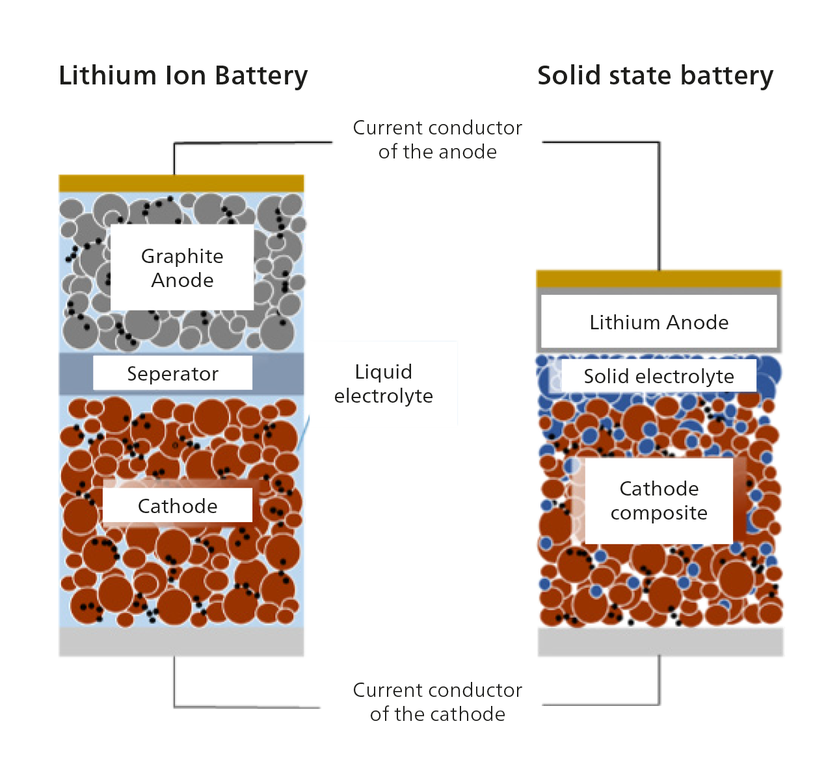
Moving to Li metal
Current collector
Main drawbacks of LIBs:
Lower energy density
Li dendrites evolution leading to short-circuit
Organic electrolytes
Safety issues
Main opportunities:
Higher theoretical energy densities (~400 Wh/kg)
Safety improvements due to the use of solid electrolytes
Current collector
Ionic conductivity of solid-state electrolytes (SEs) (10⁻⁵ – 10⁻³ S/cm).
Huge resistances due to contact issues.
Interfacial processes during cycling.
Low cyclability.
Developing sustainable SEs avoiding the use of critical raw materials.

Slide 3
Solid Electrolytes. Brief Overview
  Depending on the electrolyte used, solid state batteries are divided in two big families:
    Polymer-based ASSLiBs.
      Developed with polymeric materials as SEs.
      Thermal degradation issues limiting its applicability.
      Huge degradation on the Polymer/electrode interface.
      Low ionic conductivities (10⁻⁵ S/cm).
    Inorganic ASSLiBs.
      Developed with several different inorganic materials (oxides, halides, sulphides,…)
      Improvement in terms of safety
      Wide electrochemical stability window. (Better compatibility with high voltage cathodes)

Slide 4
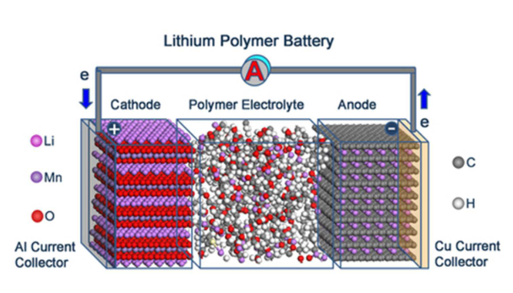
Solid Electrolytes. Brief Overview
  Depending on the electrolyte used, solid state batteries are divided in two big families:
    Polymer-based ASSLiBs.
      Developed with polymeric materials as SEs.
      Thermal degradation issues limiting its applicability.
      Huge degradation on the Polymer/electrode interface.
      Low ionic conductivities (10⁻⁵ S/cm)
J. Mater. Chem. A, 2016, 4, 10038-10069

Slide 5
Solid Electrolytes. Brief Overview
  Depending on the electrolyte used, solid state batteries are divided in two big families:
    Polymer-based ASSLiBs.
      Developed with polymeric materials as SEs.
      Thermal degradation issues limiting its applicability.
      Huge degradation on the Polymer/electrode interface.
      Low ionic conductivities (10⁻⁵ S/cm).
    Inorganic ASSLiBs.
      Developed with several different inorganic materials (oxides, halides, sulphides,…)
      Improvement in terms of safety
      Wide electrochemical stability window. (Better compatibility with high voltage cathodes)

Slide 6
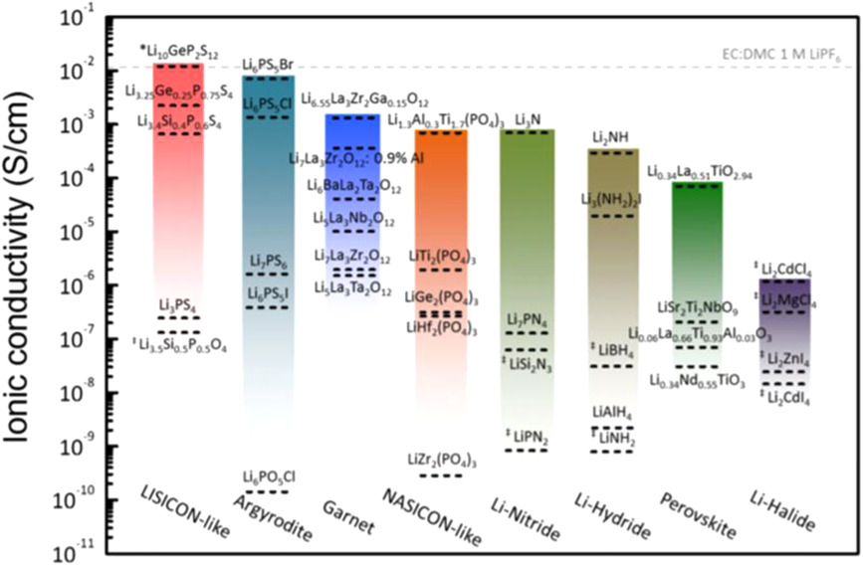
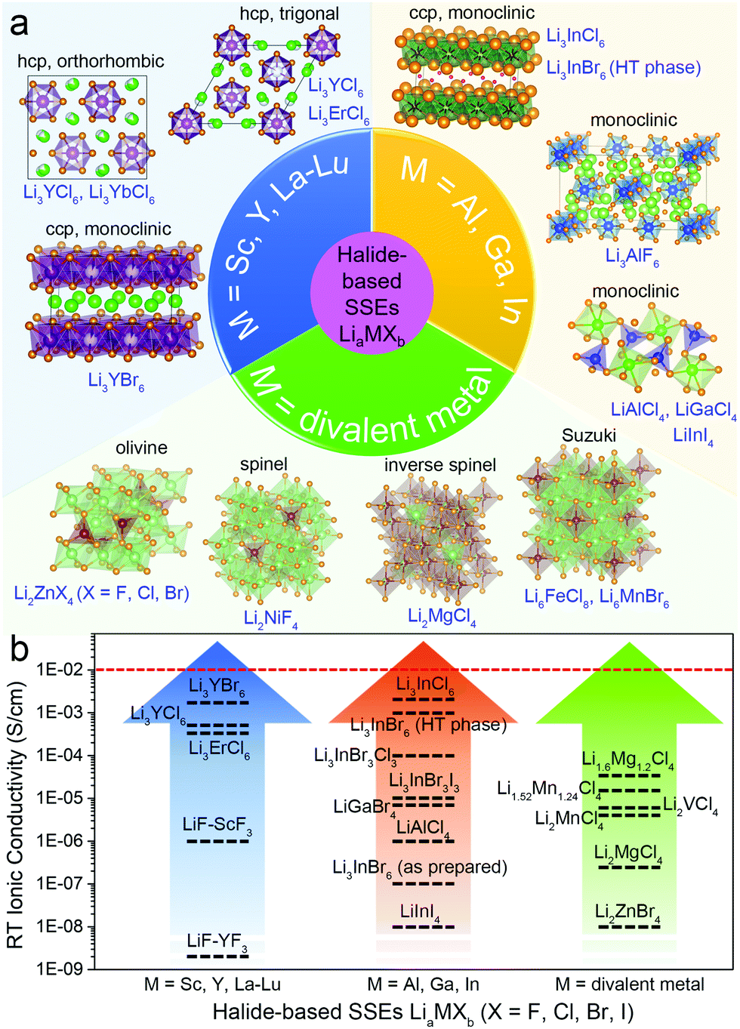
Inorganic ASSLiBs
  Generally, inorganic solid electrolytes (ISEs) are considered as promising materials due to:
Promising ionic conductivities
Good Li⁺ diffusion
High thermal stability
Electronic insulators
In contrast:
Interface issues
Conductivity depends heavily on temperature

Slide 7
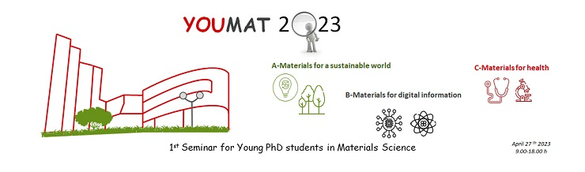
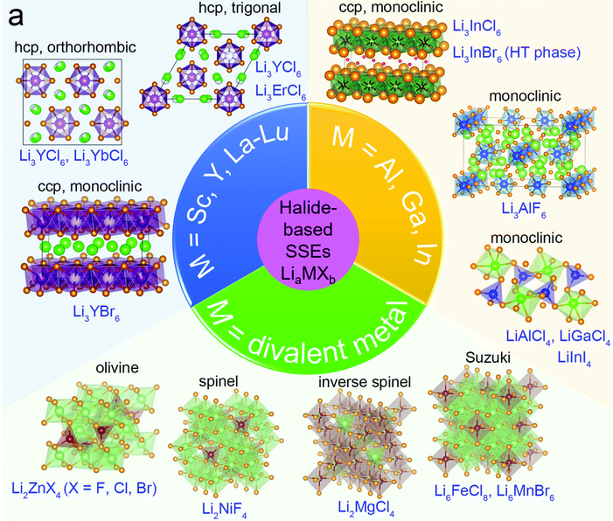
Lithium Halides (Li₃MX₆)
  Since 2018, this family of compounds have gained so much attention since the preparation by Tetsuya Asano et. Al of Li₃YCl₆ and Li₃YBr₆ reporting ionic conductivities between 0.03 and 1.7·10⁻³ S/cm
    Wide electrochemical stability window (~4 V)
    Good chemical stability against typical cathodes as LCO (LiCoO₂)
    Scalable and sustainable synthetic routes (i.e., aqueous based)
ACS Energy Lett., 2022, 7, 1776−1805

Slide 8
Lithium Halides (Li₃MX₆)
  Since 2018, this family of compounds have gained so much attention since the preparation by Tetsuya Asano et. Al of Li₃YCl₆ and Li₃YBr₆ reporting ionic conductivities between 0.03 and 1.7·10⁻³ S/cm
    Wide electrochemical stability window (~4 V)
    Good chemical stability against typical cathodes as LCO (LiCoO₂)
    Scalable and sustainable synthetic routes (i.e., aqueous based)
  Nevertheless, the ionic conductivities for these compounds are still low at low temperatures.
  Understanding the relationship between the structure and the ionic conductivity of these halides is essential.
Among the different families of halides, the most promising ones are the Li₃MX₆ since they show outstanding conductivities (~1 mS/cm), but there is still a lack of comprehension between the crystalline structure and the conductivity relationship
ACS Energy Lett., 2022, 7, 1776−1805

Slide 9
Lithium Halides (Li₃MX₆)
  Then, how can we improve the ionic conductivity of these halides?
Central metal (M) substitution
Halide (X) substitution
Synthetic route selection
ACS Energy Lett., 2022, 7, 1776−1805

Slide 10
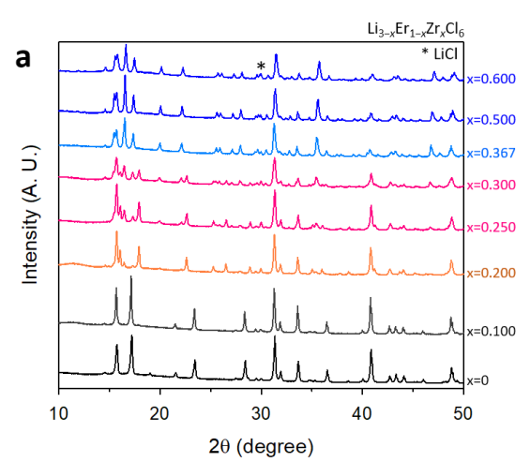
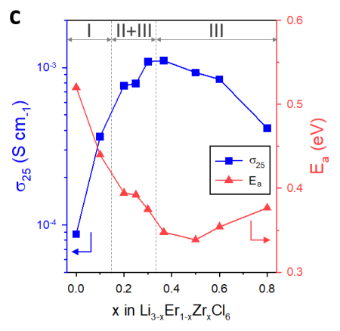
Lithium Halides (Li₃MX₆)
  Then, how can we improve the ionic conductivity of these halides?
Li_{3-x}Er_{1-x}Zr_{x}Cl₆
Zr⁴⁺ (r = 72 pm); Er³⁺ (r = 89 pm)
Central metal (M) substitution
Halide (X) substitution
Synthetic route selection
X = 0 – 0.1 → Trigonal pase (P-3m1) (Phase I)
X = 0.2 → Orthorhombic (Pnma) (Phase II)
X = 0.367 – 0.6 → “solid-solution region” (Phase III)
ACS Energy Lett. 2020, 5, 2, 533–539

Slide 11
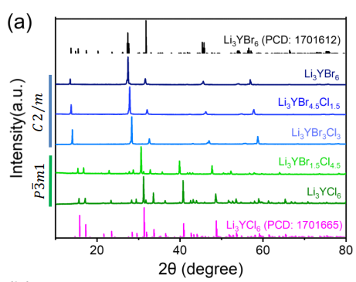
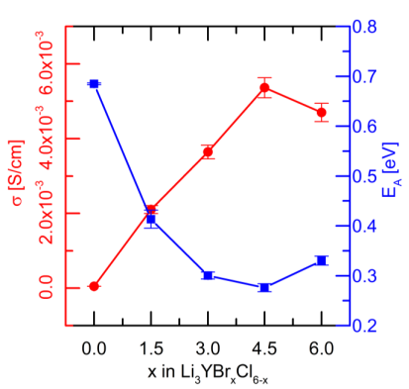
Lithium Halides (Li₃MX₆)
  Then, how can we improve the ionic conductivity of these halides?
Li₃YBr_{x}Cl_{6-x} (x = 0-6)
Central metal (M) substitution
Halide (X) substitution
Synthetic route selection
0 < x < 1.5 → Trigonal (P-3m1)
1.5 < x < 6 → Monoclinic (C2/m)
J. Phys. Chem. C, 2023, 127, 1, 125–132

Slide 12
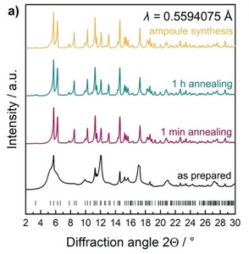
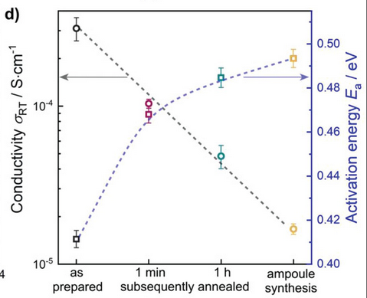
Lithium Halides (Li₃MX₆)
  Then, how can we improve the ionic conductivity of these halides?
Li₃ErCl₆ (Mecanochemical vs. Thermochemical)
Central metal (M) substitution
Halide (X) substitution
Synthetic route selection
Local disorder induced by the synthetic route could tune the ionic conductivity of the electrolyte.
Adv. Energy Mater. 2020, 10, 1903719

Slide 13
Perspectives and work plan
FUNDAMENTAL
SYNTHESIS
APLICATION
Study and understanding of the influence of different crystal structures on ionic conductivity.
Processes and mechanisms of diffusion
Solid state NMR, EIS, XRD, NPD
Comprehensive synthesis and characterization of different halides of the families (Li₃MX₆ and Li₂MX₄).
Modulation of ionic conductivity by substitution and/or doping of the central metal (Al, Ca, Fe, Mn, Zr).
Thermochemical, mechanochemical, aqueous-based synthesis
Electrochemical characterization of the synthesized electrolytes (electrochemical stability window, galvanostatic cycling, ageing tests), both in half-cell and full cell configurations.
Compatibility study with different cathodes and interphase dissemination
Integration on large area battery devices by means of robot-casting printing technique

Slide 14
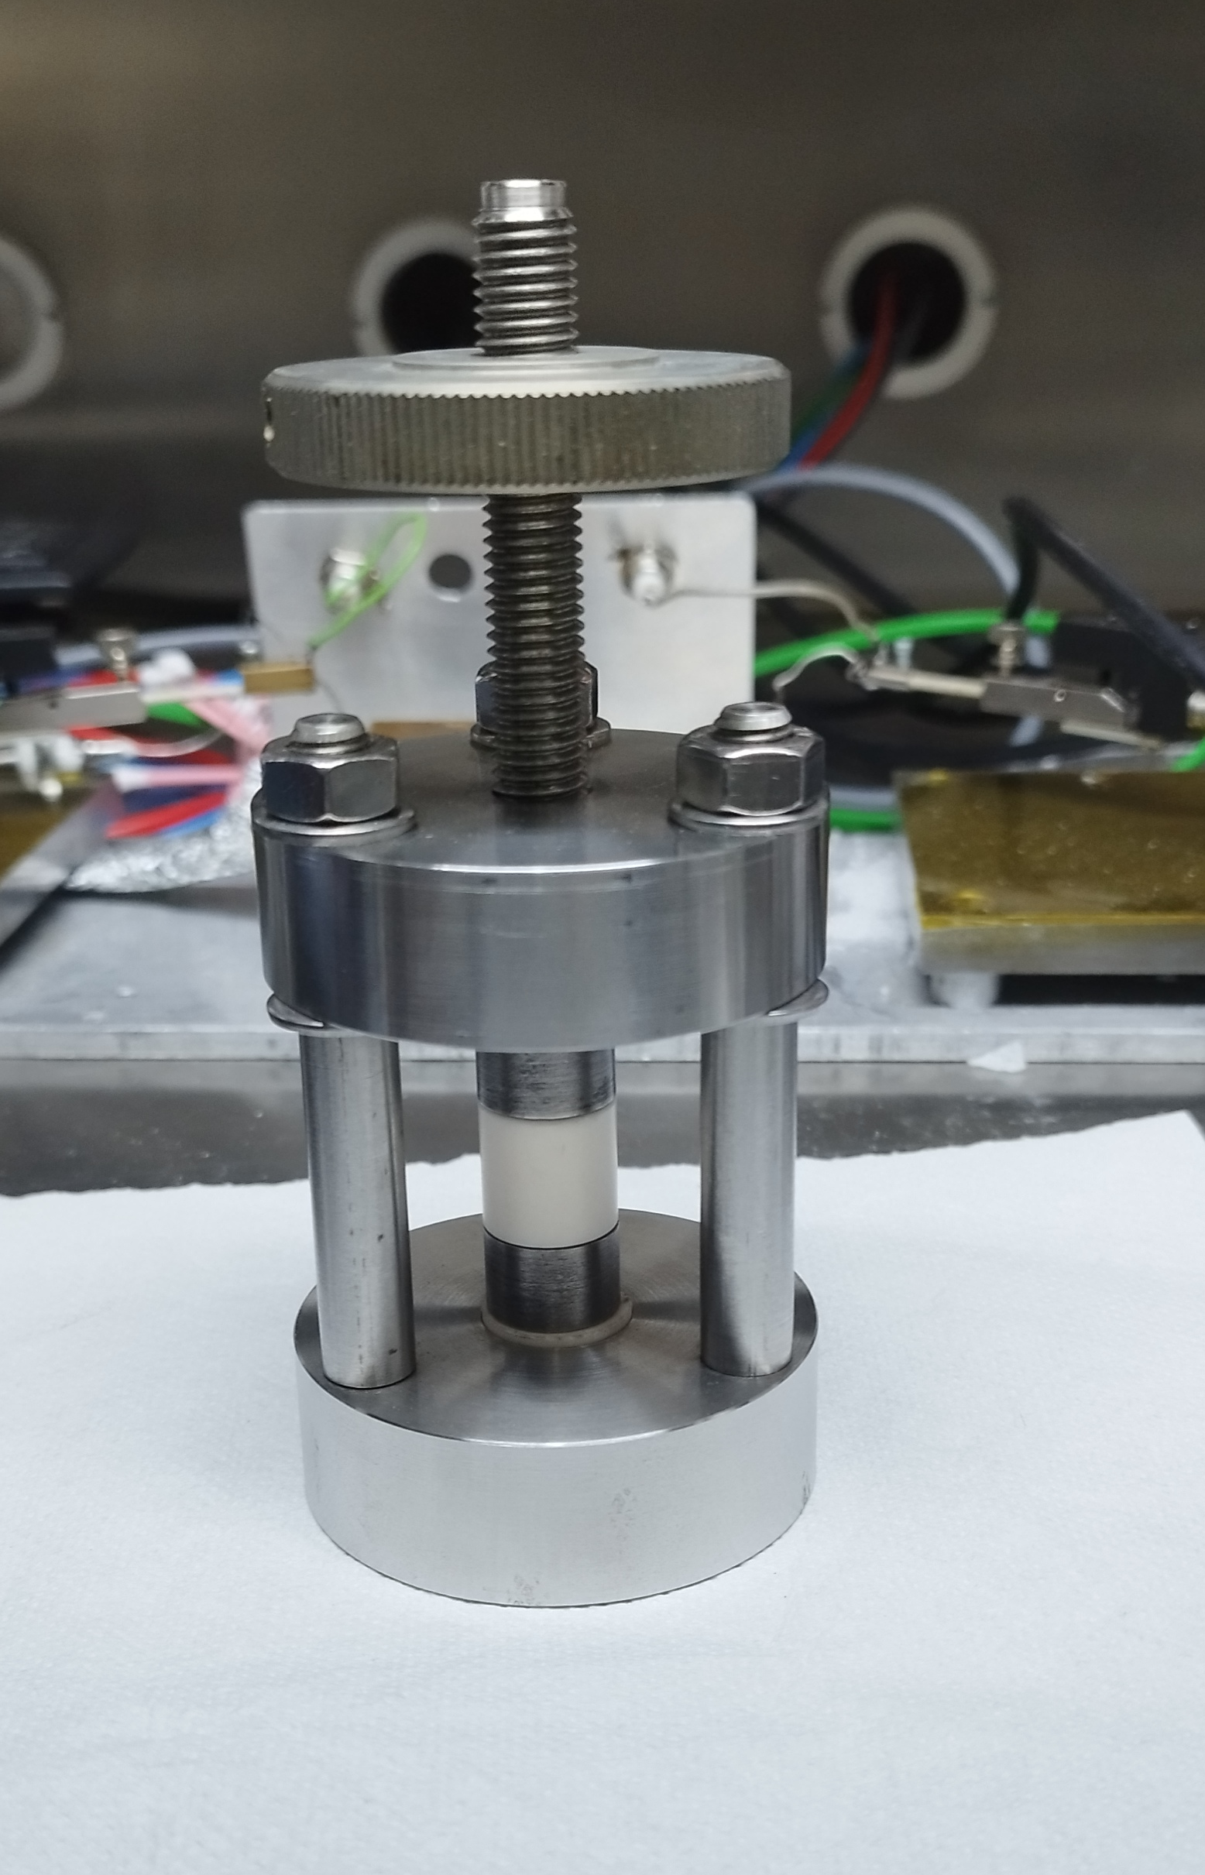
Early Results
Monoclinic - C2/m (#12)
  Li₃InCl₆ solution-based synthesis
    LiCl + InCl₃ stoichiometric mixture
    Dissolve in H₂O (1:5 w/w) overnight at room temperature
    Heat at 60 ºC (333 K) until complete evaporation
    Drying at 180 ºC in vacuum for 18 h
Ea = 0.31 eV
σ_{(25 ºC)} = 1 mS/cm

Slide 15
Early Results
  Li_{2+x}Zr_{1-x}Fe_{x}Cl₆ aliovalent substitution of Zr(IV)
    LiCl + ZrCl₄ + FeCl₃ stoichiometric mixtures (2+x:1-x:x)
    Hand ground the metallic precursors
    Put the mixture in a 45 mL ZrO₂ milling jar with ZrO₂ of 5 mm diameter as grinding media
    All the preparation was done in an Ar filled Glovebox
σ_{(25 ºC)} = 1 mS/cm
σ_{(25 ºC)} = 0.4 mS/cm

Slide 16
Conclusions
Li₃InCl₆ has been synthetized and the obtained conductivity values match those from the literature.
Iron (III) aliovalent substitution of Zr (IV) has shown to be beneficial at least in terms of ionic conductivity, however, more characterization is needed in order to fully understand the system.
This leaves the path opened to the development of new sustainable SEs based on non-critical raw materials such as Ca, Mg, Al, Fe, among others.

Slide 17
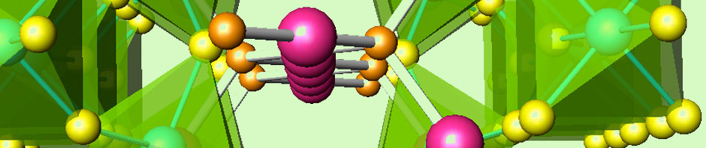
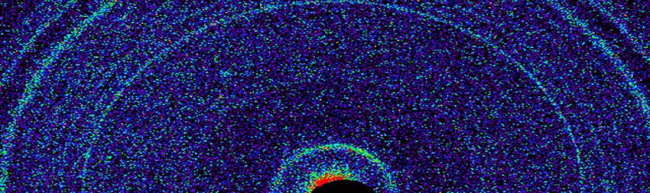

Acknowledges
Dr. Ainara Aguadero and Dr. Ricardo Jiménez for the supervision of this thesis.
SEATBELT EU project. Funding
Energy Conversion, Harvesting and Storage group.
Dr. Fátima Esteban. X-ray Diffraction Unit, ICMM.

Slide 18
Tuning the ionic conductivity and electrochemical stability of Lithium through by the aliovalent substitution
Raul Artal López. July 2023

